Slide 1

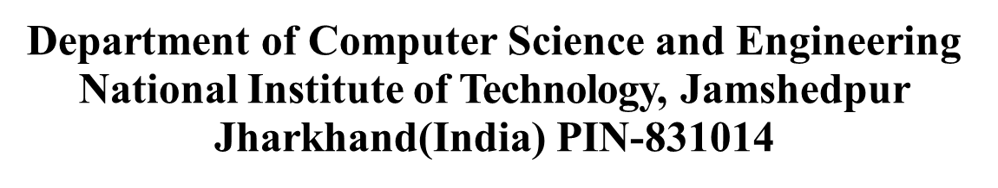

The 1st International Conference on Sustainable Communication, Machine Intelligence and Metaverse (SCMIM-2025)
A Systematic Literature Review on the Privacy and Security of Cloud-Integrated AI-Enabled Internet of Medical Things (IoMT)
Presented by
Sabarna Sarkar
Saptarshi Roychowdhury
Under the supervision of
Dr. Binod Kumar Singh
Associate professor, Dept. of CSE

Slide 2
Contents
Research Questions
Literature Survey
Findings
Conclusion
References
Introduction
Problem Statement
Enhancement
Future Scope

Slide 3
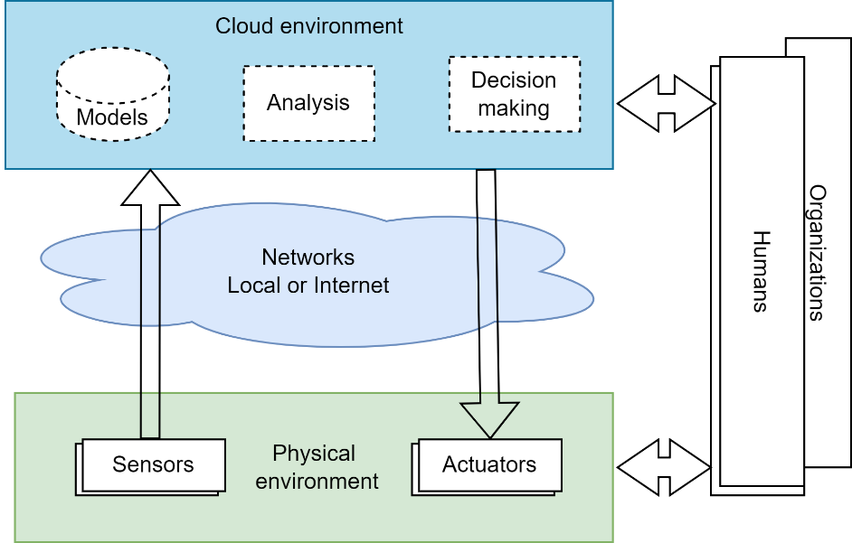
Introduction
Internet of Things
The Internet of Things (IoT) system connects physical devices like sensors and actuators to the internet, enabling data exchange and remote control. It facilitates smarter environments across industries, enhancing efficiency and automation.
IoT systems enable seamless communication between devices, allowing real-time monitoring and data-driven decision-making. They are pivotal in transforming industries like healthcare, agriculture, and transportation through automation and connectivity.
Overview of IoT Architecture
Physical Layer
Communication Layer
Data Processing Layer
Application Layer
Fig 1: IoT Architecture

Slide 4
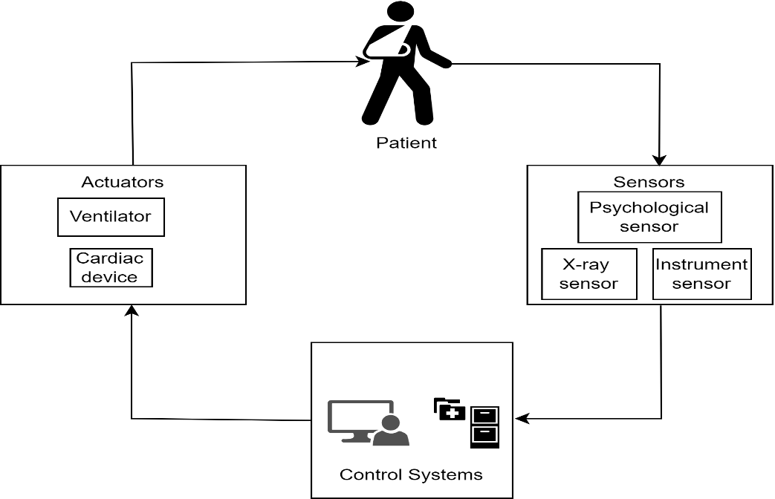
Introduction contd.
Internet of Medical Things
The Internet of Medical Things (IoMT) system is a network of interconnected medical devices, software, and healthcare systems that collect, process, and transmit patient data in real-time. It integrates IoT with healthcare to enable remote monitoring, personalized treatment, and efficient healthcare delivery.
These systems encompass a wide range of applications, including implantable medical devices (e.g., pacemakers and insulin pumps), wearable health monitors, hospital management systems, and tele-medicine platforms.
AI integration with IoMT enhances healthcare by enabling real-time data analysis, predictive diagnostics, and personalized treatment plans. It leverages machine learning and advanced algorithms to improve decision-making and overall patient care.
Unique Characteristics of IoMT
Real-Time Data Processing Needs
Patient Safety Concerns
Sensitive Data Handling
Complex and Diverse User Base
Fig 2: IoMT Systems

Slide 5
Problem Statement
The integration of cloud computing and AI into IoMT is revolutionizing healthcare by enabling efficient data management, real-time monitoring, and personalized treatments.
Significant privacy and security challenges, such as unauthorized access, data breaches, and data manipulation, threaten patient trust and IoMT adoption.
Existing solutions often struggle to balance robust security measures with efficient system performance.
This paper addresses these challenges by identifying critical threats and proposing innovative technologies to enhance privacy and security in IoMT systems.

Slide 6
Research Questions
RQ1: How can privacy challenges in IoMT systems be effectively addressed to ensure data confidentiality and compliance with regulations?
RQ2: What are the most critical security threats in IoMT systems, and how can emerging technologies mitigate these risks?
RQ3: How can privacy and security be balanced in AI-enabled IoMT systems without compromising efficiency?
RQ4: What future technologies can revolutionize privacy and security in IoMT systems?

Slide 7
Literature Survey
Table 1: Literature Survey
Reference | Title of the paper | Year | Journal Name | Main Findings
Dimitris et. al. | Security in IoMT communications: A survey | 2020 | Sensors | The study delves into the inherent security traits and constraints of IoMT-specific communication protocols by analyzing practical attacks.
George et. al. | Privacy for the Review of security and Internet of Medical Things (IoMT) | 2019 | International Conference on Distributed Computing in Sensor Systems (DCOSS) | This paper focuses on the healthcare domain's Connected Environment (CE). It covers protection mechanisms throughout the data lifecycle, from device to cloud (E2E)

Slide 8
Literature Survey contd.
Reference | Title of the paper | Year | Journal Name | Main Findings
Ioannis et al. | A survey of iot-enabled cyberattacks: Assessing attack paths to critical infrastructures and services | 2018 | IEEE Communications Surveys & Tutorials | This paper focuses on categorizing IoT communication protocols in the context of their application in the IoMT.
Da Yin et. al. | A DDoS attack detection and mitigation with software-defined Internet of Things framework | 2018 | IEEE Access | This paper focused on detecting and mitigating DDoS attacks using the SD-IoT framework.

Slide 9
Literature Survey contd.
Reference | Title of the paper | Year | Journal Name | Main Findings
S. M. Riazul et. al. | The internet of things for health care: a comprehensive survey | 2015 | IEEE Access | This paper introduces the Internet IoT as a transformative trend connecting smart devices across various sectors.
Kuan Zhang et. al. | Sybil attacks and their defenses in the internet of things. | 2014 | IEEE Internet of Things Journal | This paper focuses on a survey on Sybil's attacks and their defense.

Slide 10
Findings
Privacy Challenges
Unauthorized access to sensitive health data
Lack of transparency in data sharing and usage
Insufficient encryption and anonymization techniques
Inadequate mechanisms for data minimization to reduce sensitive data exposure
Security Threats
Malware infections, phishing, and ransomware attacks
Man-in-the-Middle (MitM) attacks compromising device communications
Distributed Denial of Service (DDoS) attacks disrupting healthcare services
Insider threats exploiting system vulnerabilities
Node injection and sinkhole attacks in IoMT networks

Slide 11
Findings contd.
Key Gaps
Limited adoption of advanced technologies like blockchain and homomorphic encryption
Difficulty in balancing privacy, security, and system efficiency
Inadequate regulatory compliance and lack of standardization
Poor interoperability among IoMT devices and platforms
Limited patient control over personal health data

Slide 12
Findings contd.
Table 2: Significant research findings on the Security and Privacy of IoMT
Attacks Vs Issues | Service Unavailabiliy | Data Interception | Unauthorized Access | Data Manipulation | Data Corruption | Data Theft | Privacy Violation | Service Disruption | Device Malfunction
DoS/DDoS | ✓ |  |  |  |  |  |  | ✓
MitM |  | ✓ | ✓ | ✓
Malware | ✓ |  | ✓ | ✓ | ✓ |  |  | ✓ | ✓
Ransom- ware | ✓ |  |  |  |  | ✓ | ✓
Phishing |  | ✓ | ✓
Replay |  |  | ✓ | ✓
SQL Injection |  |  | ✓ | ✓
Insider Attack |  |  | ✓ | ✓ |  | ✓
Firmware |  |  | ✓ |  |  |  |  |  | ✓
Side Channel |  |  |  |  |  | ✓ | ✓

Slide 13
Enhancement
Privacy Enhancements:
Implement homomorphic encryption for secure data analysis.
Enable patient-controlled data-sharing mechanisms for greater transparency.
Adopt federated learning for privacy-preserving AI.
Security Enhancements:
Use blockchain for tamper-proof data sharing and audit trails.
Deploy AI-powered intrusion detection systems for real-time threat mitigation.
Introduce multi-factor authentication and access control mechanisms.
Efficiency Balancing:
Optimize IoMT devices using lightweight encryption and edge computing.
Standardize IoMT protocols for seamless interoperability and compliance.

Slide 14
Future Scope
Homomorphic Encryption: Enables secure computations on encrypted data, protecting patient privacy during analysis.
Federated Learning: Preserves data privacy by enabling decentralized machine learning without sharing sensitive data.
Blockchain Integration: Ensures tamper-proof audit trails and secure data sharing across IoMT ecosystems.
Quantum Cryptography: Provides advanced encryption to safeguard IoMT systems against future computational threats.

Slide 15
Conclusion
The integration of cloud computing and AI with IoMT has revolutionized healthcare by enabling real-time monitoring, personalized treatments, and efficient data management.
Despite these advancements, significant challenges such as data breaches, unauthorized access, and privacy concerns persist, posing risks to patient trust and system reliability.
This study systematically reviewed these challenges and highlighted innovative solutions, including blockchain, federated learning, and homomorphic encryption, to address privacy and security gaps.
Emphasizing robust security measures, privacy-preserving technologies, and regulatory compliance is crucial to fostering trust and ensuring the widespread adoption of IoMT systems.
By addressing these challenges and leveraging emerging technologies, IoMT can unlock its full potential in transforming healthcare delivery.

Slide 16
References
Choudhury, A., Roychowdhury, S., Singh, B. K., & Singh, T. P. Introduction to Digital Society: An Overview. Evolution of Digitized Societies Through Advanced Technologies, 1–6, (2022).
Paavola, J., & Ekqvist, J. Privacy preserving and resilient cloudified IoT architecture to support eHealth systems. Interoperability, Safety and Security in IoT: Third International Conference, InterIoT 2017, and Fourth International Conference, SaSeIot 2017, Valencia, Spain, November 6-7, 2017, Proceedings 3, 134–143. Springer (2018).
Stellios, I., Kotzanikolaou, P., Psarakis, M., Alcaraz, C., & Lopez, J. A survey of iot-enabled cyberattacks: Assessing attack paths to critical infrastructures and services. IEEE Communications Surveys & Tutorials, 20(4), 3453–3495, (2018).
Roy, T., & Nahid, M. M. The IoMT and cloud in Healthcare: Use, impact and efficiency of contemporary sensor devices used by patients and clinicians. Proceedings of the 2nd International Conference on Computing Advancements, 426–434, (2022)..
Buchanan, W. J., Kwecka, Z., & Ekonomou, E. A privacy preserving method using privacy enhancing techniques for location-based services. Mobile Networks and Applications, 18, 728–737, (2013).
Gentry, C., & Halevi, S. Implementing gentry’s fully-homomorphic encryption scheme. Annual International Conference on the Theory and Applications of Cryptographic Techniques, 129–148. Springer, (2011).
Arigbabu, A. T., Olaniyi, O. O., Adigwe, C. S., Adebiyi, O. O., & Ajayi, S. A. Data governance in AI-enabled healthcare systems: A case of the project nightingale. Asian Journal of Research in Computer Science, 17(5), 85–107, (2024).

Slide 17
Thank You

